Slide 1
How to Discover your Midlife Entrepreneurial Mojo
Pat Duckworth
India International Centre, Delhi,
May 2017

Slide 2
Midlife Statistics UK
1.8 million self-employed people over 50, an increase of 21% on 2008.
20% people aged over 50 self-employed, a higher proportion than for any other age group.
70% of businesses started by people in their 50s survive for at least 5 years. Only 28% of those started by younger people last that long.
62% of women and 59% of men over 50 want to continue working beyond state pension age.
2008 24% of men and 37% of women in the UK had incomes which were less than adequate to meet their needs.

Slide 3
Midlife Statistics USA
23% of all new entrepreneurs are age 50-65
average age of the founders of U.S. technology companies is 39, with twice as many over age 50 as under age 25.

Slide 4
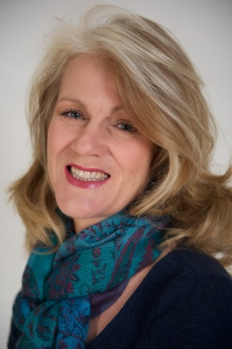
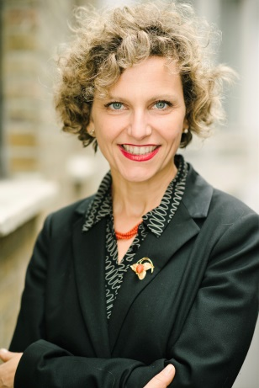
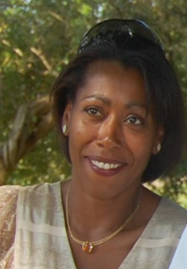
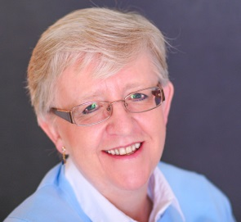
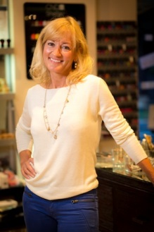
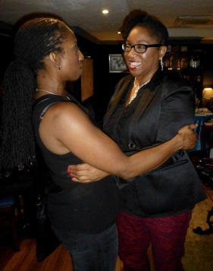
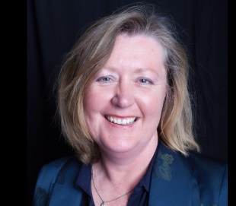
Midlife Entrepreneurs
Changes in personal relationships
Changes in financial situation
Children leaving home
Dissatisfaction with work
Pursuing a dream

Slide 5
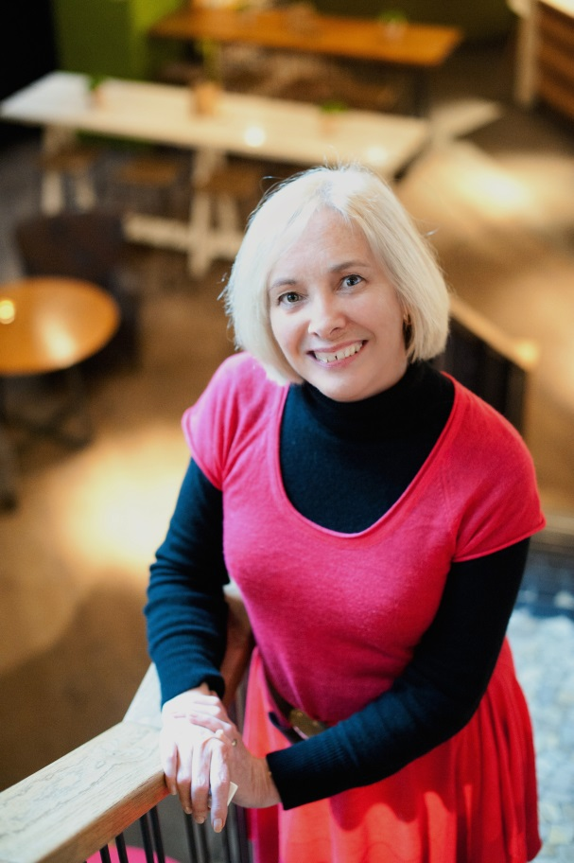
My Story Part 1
Left school at 18
Chartered Surveyor
Civil Servant
MBA at 51
Senior Civil Servant 52

Slide 6
Midlife Characteristics
Knowledge
Experience
Connections
Financial Security
Sense of Purpose
Changed priorities

Slide 7
Aligning Your Neurological Levels
Purpose/Spirituality For Whom? For What?
Identity Who?
Beliefs &Values Why?
Capabilities How?
Behaviour What?
Environment Where?
Notes:
Developed by Robert Dilts from work by Gregory Bateson
We all operate at different levels of thinking and being at different moments.
Environment – basic level of operation, the external constraints we work within eg time, place and people. The physical context
Behaviour – guided by our mental maps and strategies which define our capabilities. What you say, do and think. Aimed at a positive intention
Capabilities – your talents and skills. Contains all those things that define our competence to ourselves. We are naturally great learning machines
Beliefs and values – fundamental principles that shape our actions. Beliefs organise our model of the world. Your beliefs will be different to mine. Values provide motivation for what we do eg money v fun
Identity - describes your sense of who you are. A person’s identity is separate from their behaviour eg “Men behaving badly” does not mean men are intrinsically bad , it’s just bad behaviour

Slide 8
Values
“At the core of motivation and culture. Answers the question ‘Why’.”
Robert Dilts
“internal and subjective and represent that which we feel strongest about in guiding our behaviour.”
Stephen Covey

Slide 9

Like a stick of rock

Slide 10
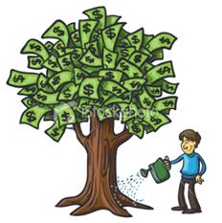



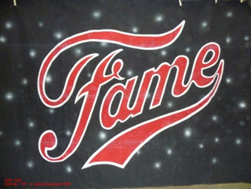


What do you value?

Slide 11
Beliefs
‘Generalisations about the world and our opinions about it. They form the rules about what we can and cannot do.’ Lazarus (2010)
Fundamental judgements and evaluations about ourselves - limbic system

Slide 12
Where do beliefs come from?
Parents and family,
teachers,
friends,
society,
Religion
books and other media.

Slide 13
Unhelpful Beliefs
Limiting
  ‘I’m too old’
  ‘Women like me don’t do this’
  ‘It’s too late’
  ‘I don’t have the skills I need’
  ‘If I ask for help other people will think I am weak.
  ‘If I don’t succeed I will be a failure’

Slide 14
Helpful Beliefs
Enabling
    ‘Age is just a number’
    I can be a role model for other women’
    ‘It’s never too late’
    ‘I can learn’
    ‘I can ask for help if I need it’
    ‘There is no failure, there is only feedback’

Slide 15
The good news is…
You can change your beliefs
List your beliefs about being an entrepreneur
For each negative belief, write a positive belief
Act as if a different belief is true
  Look for evidence of the new belief

Slide 16
Capabilities
Managerial Skills
Technical Skills
Entrepreneurial Skills

Slide 17
Entrepreneurial Skills
Creativity
Risk Management
Resilience
Determination
Flexibility
Tolerance of uncertainty
Goal-setting

Slide 18
Audit your skills
Do setbacks motivate you to try harder?
Do you have a clear vision of where the business will take you?
Can you turn your ideas into a business?
Do you know how to evaluate your business?

Slide 19




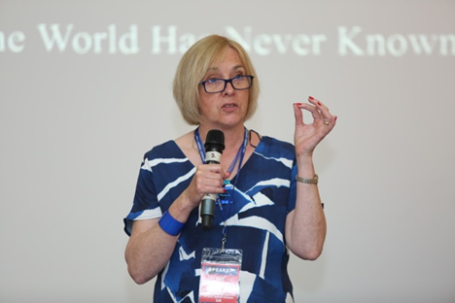
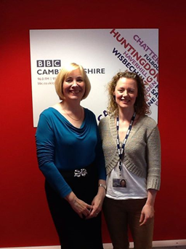
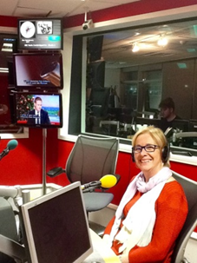
My Story Part 2

Slide 20
If you would like to know more:
patduckworth12@gmail.com
W: patduckworth.com
W: hotwomencoolsolutions.com
Twitter @patduckworth
Facebook
facebook.com/HWRentrepreneurs/

